Slide 1
Mathematics for Computing - 22MAT122
Elements of Computing II - 22AIE113
"SVM and Its Applications: Skin Cancer Detection & Customer Insights"
TEAM MEMBERS:
1.HIMABALA - CB.SC.U4AIE24028
2.NIKHIL - CB.SC.U4AIE24053
3.SANDEEP - CB.SC.U4AIE24047
4.CHAITHANYA - CB.SC.U4AIE24040

Slide 2
INTRODUCTION:
OUR PROJECT IS :
Our project explores Support Vector Machine (SVM), a machine learning algorithm used for classification and pattern recognition.
It combines concepts from Mathematics for Computing 2 and Elements of Computing to apply SVM in two key areas: Skin Cancer Detection and Customer Insights Analysis.
In Skin Cancer Detection, the HAM10000 dataset is used to classify skin lesions as benign or malignant, improving early diagnosis accuracy.
In Customer Insights, SVM analyzes patient data (age, gender, and lesion type) to identify trends and risk factors, aiding healthcare research.
In this project, We will implement SVM in MATLAB, process medical images, train the model, evaluate its accuracy, and analyze customer data to extract meaningful insights.
1

Slide 3

Software, Tools & Languages Used in the Project
Programming Language: MATLAB (for implementing machine learning and image processing).
Software: MATLAB (used for coding, training models, and visualizing results).
Dataset: HAM10000 (contains medical images for skin cancer detection).
Machine Learning Algorithm: Support Vector Machine (SVM) (for classification tasks).
Libraries & Toolboxes:
Image Processing Toolbox (for handling and preprocessing medical images).
Statistics and Machine Learning Toolbox (for implementing and training SVM).
MATLAB’s built-in functions (for data classification, visualization, and accuracy evaluation).
2

Slide 4

RELEVANCE OF OUR PROJECT:
Early Detection of Skin Cancer:
Skin cancer is a serious health issue, and early detection can save lives.
Using SVM for classification improves accuracy and speeds up diagnosis.
Real-World Applications in Healthcare & Business:
Machine learning is widely used in medical diagnosis and customer insights analysis.
This project demonstrates how SVM can be applied in multiple fields effectively.
Combines Mathematics & Computing:
Integrates mathematical models (SVM) with computing tools (MATLAB).
Aligns with two subjects, Mathematics for Computing 2 and Elements of Computing .
Real-World Applications & Learning:
Demonstrates how AI and machine learning are used in healthcare and business.
Provides practical experience in data analysis, image processing, and classification.
3

Slide 5
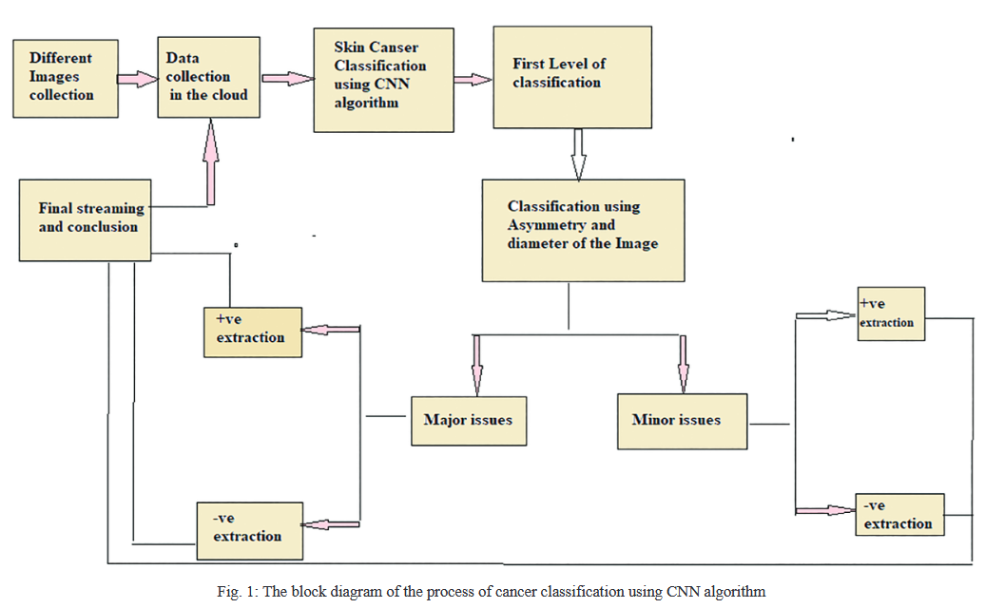
LITERATURE REVIEW-1Year of Publication: 2022
TITLE:Skin Cancer Classification using CNN in Comparison with SVM.
Methodology:
The study compares CNN and SVM for skin cancer classification using a Kaggle dataset.
CNN automatically extracts features, while SVM relies on handcrafted feature selection for classification.
Limitations:
Small dataset size (only 30 images per model), which may affect generalizability.
Computationally intensive – CNN requires high processing power compared to SVM.
Metrics :
Accuracy & Specificity are the primary evaluation metrics.
SPSS(Statistical Package for the Social Sciences) software is used for statistical validation of results.
Advantages:
Provides a direct comparison between CNN & SVM for medical image classification.
Has real-world applications, helping in automated skin cancer detection for early diagnosis.
4

Slide 6
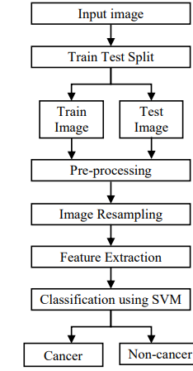
Paper 2: Skin Cancer Detection Using Support Vector Machine with Histogram of Oriented Gradients Features year of publication:2021
Methodology:
Uses Histogram of Oriented Gradients (HOG) for feature extraction from skin images.
Applies Support Vector Machine (SVM) for classification of malignant and benign lesions.
Limitations:
Feature selection dependency – HOG-based feature extraction may not capture deep image details.
Dataset limitations – Study does not specify if it used HAM10000, limiting comparability.
Metrics:
Uses accuracy, sensitivity, and specificity to evaluate classification performance.
Compares results with other ML models to validate SVM effectiveness.
Advantages:
Lightweight and efficient – Works well on low-resource systems compared to deep learning models.
Proves SVM’s reliability in medical image classification.
5

Slide 7
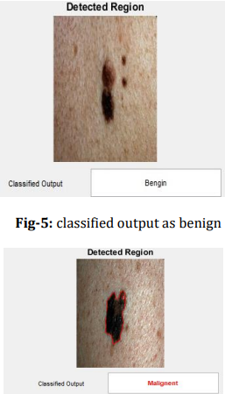
PAPER 3:Detection of Skin Cancer Using SVM year of publication:2017
Methodology:
Uses image processing techniques like grayscale conversion, segmentation, and thresholding.
Trains an SVM classifier on extracted features to differentiate between cancerous and non-cancerous skin lesions.
Limitations:
Limited dataset size – Small number of samples may reduce generalization.
Basic feature extraction – Lacks deep texture analysis, which can affect classification accuracy.
Metrics:
Evaluates accuracy, precision, recall, and F1-score for model assessment
Uses confusion matrix to validâtes classification results.
Advantages:
SVM proves to be effective for medical image classification.
Simpler than deep learning models, requiring less computational power.
6

Slide 8
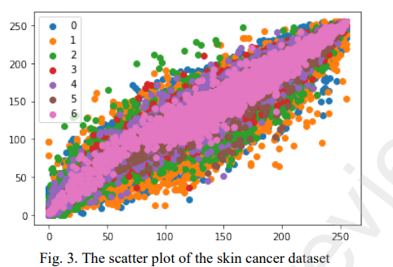
PAPER 4:Skin Cancer Detection Using Ensembled Support Vector Machines year of publication:2022
Methodology:
Uses an ensemble of three SVM classifiers to improve skin cancer detection.
Uses the dataset HAM10000.
Limitations:
High computational cost due to multiple SVM classifiers.
Limited generalization as the model is tested only on HAM10000.
Metrics:
Accuracy, Precision, and Recall to evaluate classification effectiveness.
F1-score and Cross-Validation to ensure model robustness.
Advantages:
Achieves 98% accuracy, outperforming traditional SVM models.
7

Slide 9
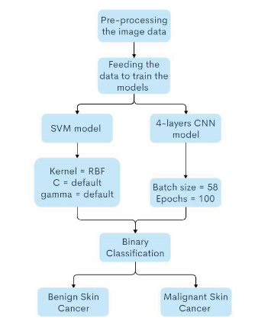
Paper 5: Binary classification of Melanoma Skin cancer using SVM and CNN year of publication:2021
Methodology:
A CNN-based classifier is used to detect and classify seven types of skin lesions from the HAM10000 dataset. The approach includes data preprocessing, augmentation, hyperparameter tuning, and model optimization to achieve high accuracy.
Limitations:
The model may suffer from bias due to dataset imbalance, require extensive computational resources, and struggle with generalization to images from different sources or real-world clinical settings.
Advantages:
It offers automated, fast, and highly accurate skin lesion classification, reduces dependency on dermatologists, and minimizes human error in diagnosis.
Metrics:
The performance is evaluated using accuracy (99.13%), precision (97%), recall (97%), and F1-score (97%), ensuring reliable classification across different lesion types.
.
8

Slide 10
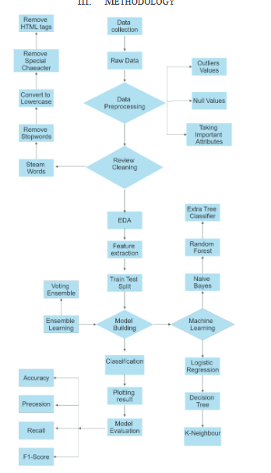
Paper 6:Enhancing E-commerce Insights: Sentiment Analysis Using Machine Learning and Ensemble Techniques year of publication:2023
Methodology:
The research applies machine learning techniques, including Naïve Bayes, Random Forest, Decision Tree, Extra Trees, and Logistic Regression, for sentiment analysis of customer reviews. A voting ensemble method combines individual model predictions to improve accuracy.
Limitations:
The model's accuracy may be affected by dataset imbalance, potential bias from web-scraped data, and challenges in handling sarcasm or complex language structures in sentiment classification.
Advantages:
It provides automated sentiment insights, enhances e-commerce decision-making, and improves customer experience analysis through robust ensemble learning techniques.
Metrics:
The evaluation uses accuracy (99%), precision (0.98), recall (0.98), and F1-score (0.98), with the Random Forest and ensemble methods achieving the highest performance​
9

Slide 11
What is "HAM10000" dataset?
The HAM10000 dataset is like a massive collection of skin images used to train AI models to detect skin cancer.
It contains 10,015 high-quality images of different skin conditions, such as melanoma (a serious type of skin cancer) and benign lesions.
Researchers and doctors use HAM10000 to teach machine learning models like SVM and CNN how to recognize dangerous skin conditions early, helping improve diagnosis and treatment.
10

Slide 12
PROBLEM STATEMENT
Skin Cancer Detection is Slow and Inconsistent
Traditional diagnosis is manual, time-consuming, and prone to errors.
An SVM-based AI system could help dermatologists detect cancer faster and more accurately
SVM Needs Optimization for Medical Images
The model’s performance depends on choosing the right features, which is tricky.
We need better feature extraction methods to improve skin lesion classification accuracy
SVM is Not Scalable for Large Dataset.
Processing HAM10000 images takes time because SVM is computationally expensive.
We need optimization techniques to make SVM work faster and handle bigger datasets
Lack of Data-Driven Insights in Healthcare
Hospitals don’t always analyze trends in patient demographics (age, gender, lesion type).
Using SVM for customer insights could help identify high-risk groups and improve healthcare planning
Need for a Practical, Scalable AI Model
Many AI models fail to integrate into real-world hospital systems.
The goal is to develop an efficient, scalable SVM-based system that can assist in skin cancer diagnosis
To solve these issues, we propose a structured approach using SVM for both skin cancer
detection and customer insights analysis
11

Slide 13
PROPOSED METHOD
Data Collection & Preprocessing
Use the HAM10000 dataset, which contains 10,015 images of different skin lesions.
Apply image preprocessing techniques like resizing, contrast enhancement, and noise removal to improve image quality.
Convert images into feature vectors using texture, color, and shape-based feature extraction methods.
Feature Extraction & Selection
Extract key image features (e.g., color histogram, edge detection, texture analysis).
Use Principal Component Analysis (PCA) or other techniques to reduce dimensionality and select the most important features.
SVM Model Training & Classification
Train a Support Vector Machine (SVM) classifier to differentiate between benign and malignant lesions.
Optimize hyperparameters like kernel type (linear, RBF, polynomial) for the best classification performance.
Use cross-validation to improve model generalization
12

Slide 14
WHY DO WE USE ONLY SVM
1. SVM Works Well for Medical Image Classification
SVM is highly effective for binary and multi-class classification problems, making it suitable for skin cancer detection (benign vs. malignant).
It finds the optimal decision boundary to separate different lesion types, ensuring high classification accuracy.
2. SVM Performs Well with Small to Medium-Sized Datasets
The HAM10000 dataset (10,015 images) is not extremely large, so SVM can process it efficiently.
SVM performs well even with smaller datasets, unlike deep learning models that require large-scale training data
3. SVM is Less Computationally Expensive Than Deep Learning
CNNs and deep learning models require high-end GPUs and large computational power.
SVM works well on regular systems, making it more accessible and efficient for this project.
4. SVM is Effective When Feature Engineering is Done Well
Unlike CNNs, which learn features automatically, SVM requires feature extraction (color, texture, shape).
With proper feature selection, SVM can achieve high accuracy in medical image classification.
13

Slide 15

MATHEMATICAL ALGORITHM
Mathematical Algorithm for SVM in Skin Cancer Detection.
15151515151515151515151515
Explanation of Terms:
w→ Weight vector that defines the orientation of the decision boundary.
b → Bias term that shifts the decision boundary.
xi→ Feature vector representing an input image (e.g., colour, texture, shape).
Yi→ Class label (+1 for malignant, -1 for benign).
||w||^2 → Norm (magnitude) of the weight vector, which is minimized to maximize the margin between classes.
Yi (w ⋅ xi + b) ≥ 1→ Ensures all samples are correctly classified with maximum separation
14

Slide 16
Applications of the Project:
Healthcare (Skin Cancer Detection) :
Early diagnosis of skin cancer using SVM-based classification.
It helps with automated detection & decision support.
2. Retail & Marketing (Customer Insights):
Analyses customer data for segmentation, preferences & trends.
Helps businesses in targeted advertising & personalized recommendations
3. Data Science & Analytics:
Enhances understanding of predictive modeling & pattern recognition.
Can be integrated with other ML techniques for advanced analysis.
15

Slide 17
Advantages & Real-World Applications:
Early & Accurate Skin Cancer Detection – AI-driven diagnosis improves treatment outcomes and saves lives.
Multi-Domain Applications – SVM is used in both healthcare (medical imaging) and business (customer insights).
Automation & Time-Saving – Reduces manual work in diagnosis and data analysis, increasing efficiency.
Improved Decision-Making – Provides valuable insights for doctors in healthcare and businesses in marketing.
Security & Fraud Detection – SVM is applied in biometrics, fraud detection, and cybersecurity.
Personalized Recommendations – By Using it in e-commerce and retail to analyze the customer behavior and preferences.
16

Slide 18
RESEARCH GAPS
SVM may not work well on all datasets because the images in real-world hospitals will be different, and SVM’s accuracy will be dropped.
Processing thousands of images is slow, making real-time diagnosis impractical.
Choosing the right features is difficult because if you select wrong feature(like texture or colour) the model might misclassify skin cancer types.
Mainly it is commonly not used in hospitals because doctors prefer AI models that work in real time, and SVM is not widely used so more research is needed to make SVM-practical for real-time medical applications.
17

Slide 19
Key Concepts Used in the Project:
Mathematics for Computing 2
Elements of Computing
Sl.no | Concept | Application in Project
1. | Machine Learning (SVM Classification) | Builds an SVM model to detect skin cancer and analyze customer data.
2. | Mathematical Optimization | Finds the best hyperplane for classification by optimizing SVM parameters.
Sl.no | concept | Application in project
1. | Data Analysis & Visualization | Analyzes customer demographics (age, gender, lesion type) for insights.
2. | Computing & Software Implementation | Implements SVM-based classification and analysis in MATLAB.
18

Slide 20
Algorithms Used in the Project:
Mathematics for Computing 2
Elements of Computing
Sl.no | Algorithm | Application in Project
1. | Support Vector Machine (SVM) | Classifies skin cancer (benign/malignant) and analyzes customer insights.
2. | Feature Extraction Techniques | Extracts texture, color, and shape features for accurate classification.
Sl.no
Algorithm
Application in Project
Sl.no | Algorithm | Application in Project
1. | Data Preprocessing (Resizing, Noise Removal, Normalization) | Prepares images for better model accuracy and reliability.
2. | Performance Metrics (Accuracy, Precision, Recall, F1-Score) | Evaluates SVM’s classification performance and optimization.
19

Slide 21
Objectives of the Project:
Develop an AI-Based Skin Cancer Detection System:
Implement Support Vector Machine (SVM) to classify skin lesions as cancerous or non-cancerous.
Use the HAM10000 dataset to train and test the model for accuracy.
Provide an automated and early diagnosis system to assist doctors in decision-making .
To Implement Customer Insights Analysis Using SVM:
Analyze customer behavior patterns using machine learning.
Classify customers into different segments based on preferences, purchases, or engagement.
Provide insights for personalized recommendations and marketing strategies.
Demonstrate the Versatility of SVM in Multi-Domain Applications:
Showcase how SVM can be applied in both healthcare (skin cancer detection) and business (customer insights).
Develop a User-Friendly System for Practical Use:
Create a simple MATLAB-based interface for medical diagnosis and customer analysis
Ensure the model is easy to use and provides clear insights for end-users.
20

Slide 22
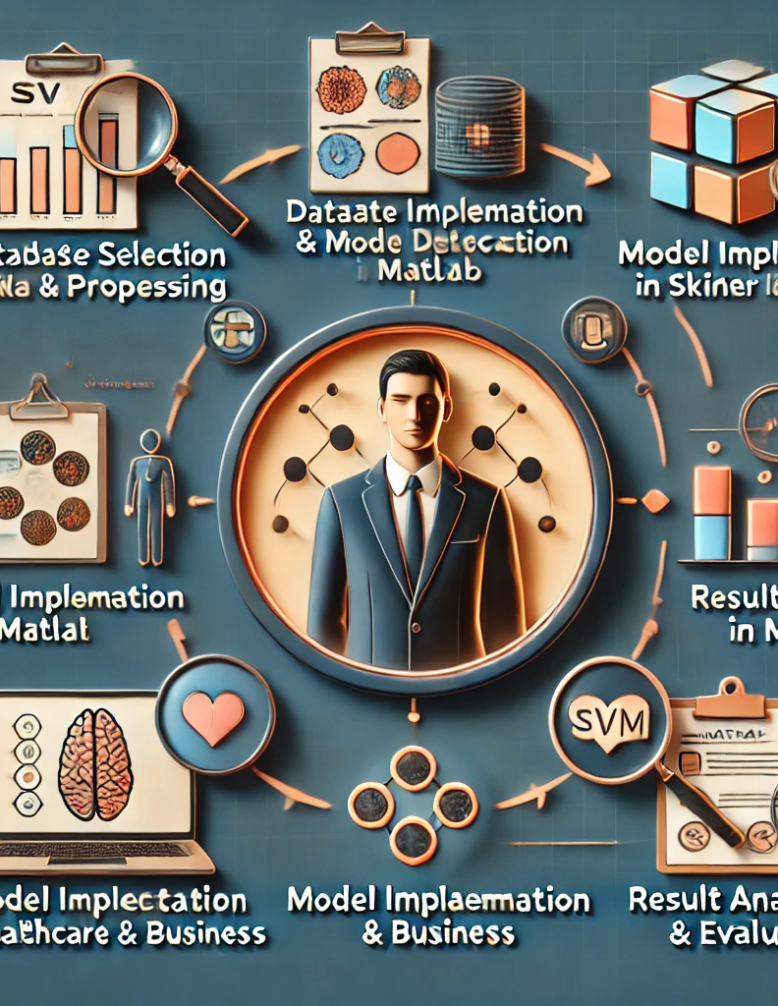
METHODOLOGY:
Dataset Selection & Preprocessing:Use the HAM10000 dataset for skin cancer detection and a relevant dataset for customer insights.
Perform data cleaning, normalization, and feature extraction for better model accuracy.
2. Model Implementation in MATLAB:Implement Support Vector Machine (SVM) for classification of both skin cancer images and customer data.
3. Application in Healthcare & Business:
Train the model to classify benign vs. malignant skin lesions
4. Result Analysis & Evaluation:
Evaluate the model’s accuracy using metrics like precision, recall, and F1-score.
Compare SVM with other machine learning models for performance validation.
21

Slide 23
LIMITATIONS
1. Computational Complexity:
SVM requires significant computational power for training, especially with large datasets like HAM10000.
Processing thousands of images can be time-consuming and memory-intensive.
2. Feature Selection Challenges:
The accuracy of SVM depends on selecting the right features from images and customer data.
Poor feature selection may lead to misclassification or reduced performance.
3. Kernel Selection Sensitivity:
The choice of the SVM kernel (linear, RBF, etc.) impacts performance.
Selecting the wrong kernel may lower classification accuracy.
4. Limited Scalability:
As the dataset size grows, SVM struggles to handle large-scale real-time applications efficiently.
It is not as effective for handling big data applications without optimization techniques.
22

Slide 24
📅 Project Timeline
Week 1-2: Research & Data Collection:
Study SVM and collect HAM10000 & customer data.
Week 3-4: Data Preprocessing & Feature Extraction:
Organize images, extract features, and clean customer data.
Week 5-6: Model Training:
Train SVM models for skin cancer detection & customer insights.
Week 7-8: Testing & Optimization:
Evaluate performance using accuracy, precision, and recall.
Week 9: Integration & Finalization:
Combine models, refine results, and prepare report & presentation.
23

Slide 25
CONCLUSION
Support Vector Machine (SVM) in skin cancer detection and customer insights analysis using the HAM10000 dataset. By applying feature extraction and classification techniques, SVM provides a reliable, computationally efficient solution for distinguishing benign and malignant skin lesions.
Despite challenges like feature selection and computational cost, SVM remains a strong choice due to its accuracy, scalability for medical image classification, and ease of implementation in MATLAB. Future enhancements could include optimizing feature selection techniques and integrating larger datasets to improve real-world applicability
24

Slide 26
THANKYOU

